Slide 1
Iowa Vendors Associations

Slide 2
Database Collection

Slide 3
Iowa Liquor Sales
Data Description
This data is a representative sample of sale activity for Iowa alcohol in the United States. We represent the Iowa Vendors Association
Basic Columns
Problems to answer
Date
Vendor
Store
County/City
Liquor Category
Liquor Name
Bottles Sold
Volume Sold
Sales in Dollars
Retail/Cost Price
Which is the most sold category and individual liquor in the United States?
Which is the most profitable vendor?
Which is the most profitable county and city for Iowa?
Does Iowa vendor association reach its monthly targets?
What is the evolution of Iowa's profitability?
How would a change in price potentially affect the total profit?

Slide 4
Data cleaning

Slide 5
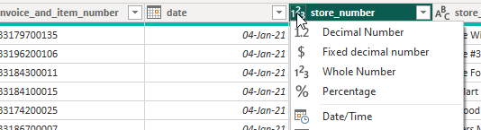
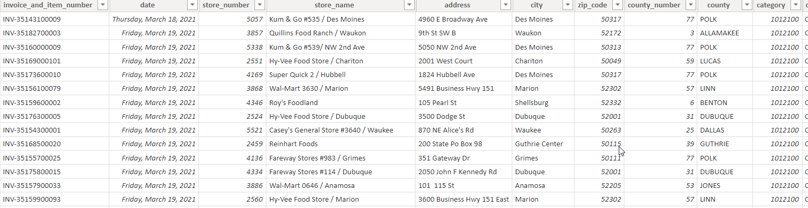
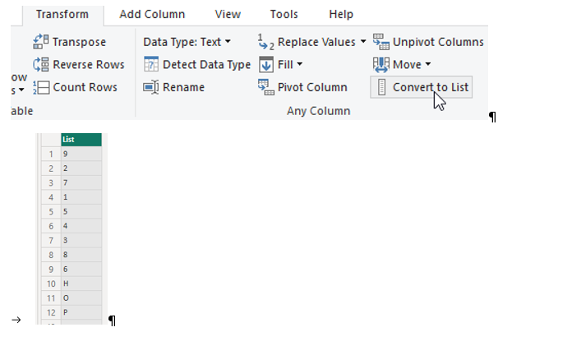
Power BI
Basic Checks
Column Type/Format
Value Inconsistencies
Empty Values
Duplicates

Slide 6
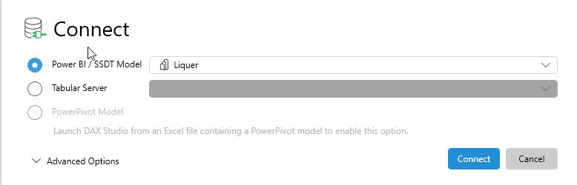
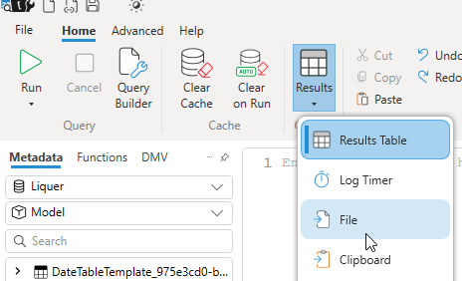
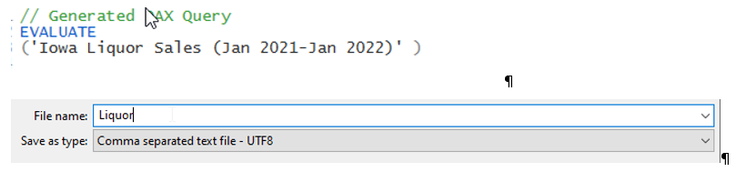
Dax Studio

Slide 7
Database Import

Slide 8
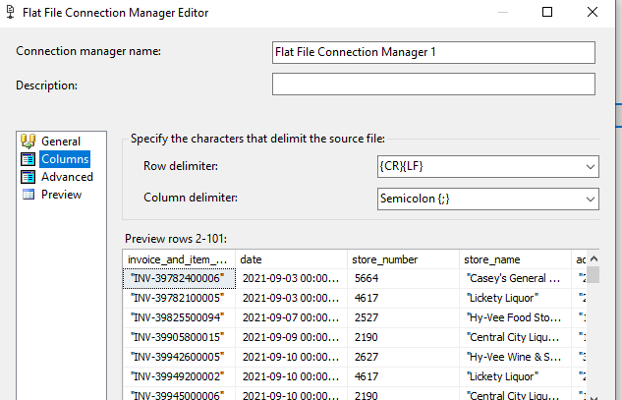
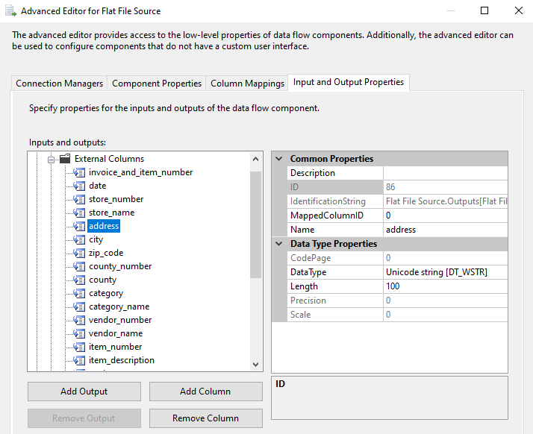
SSIS
Data Flow Task
Flat Source File
OLE DB Destination
Import of CSV file
Determine column Types
Establish server connection
Create target table

Slide 9
Dimension and fact tables

Slide 10
Which columns will be used for dimension tables?
Dimension Tables
Fact Table
Store_Name
Address
City
County
Zip_code
Category
Item_description
Vendor_name
Date
Invvoice_and_item_number
Pack
Bottle_volume_ml
State_bottle_cost
State_bottle_retail
Bottles_sold
Sale_dollars
Volume_sold_liters

Slide 11
Dimension Tables
County
Item
Date
Category
City
Zip
Address
Store
Vendor

Slide 12
Fact Table
Primary Key
Foreign Keys
Measures
Invoice
Date
Store
Vendor
Item
Pack
Bottle_volume_ml
State_bottle_cost
State_bottle_retail
Bottles_sold
Sales_dollars
Volume_sold_liters
Volume_sold_gallons
Total_Revenue
Total_Cost
Total_Profit

Slide 13
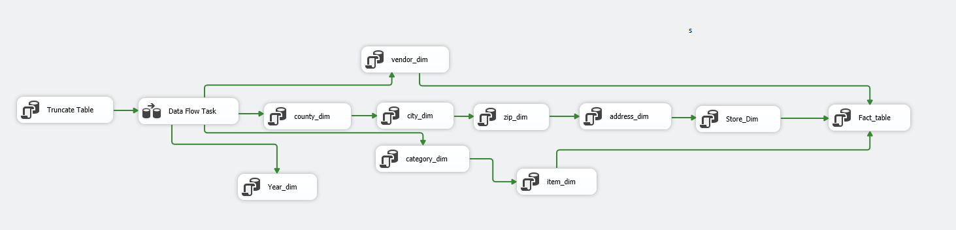
SSIS Automation

Slide 14
Cube Creation

Slide 15
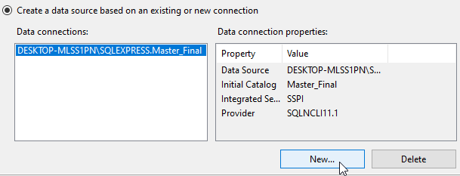
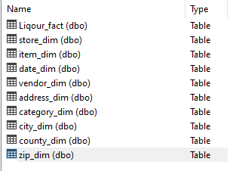
SSAS
Data Sources
Data Source Views

Slide 16
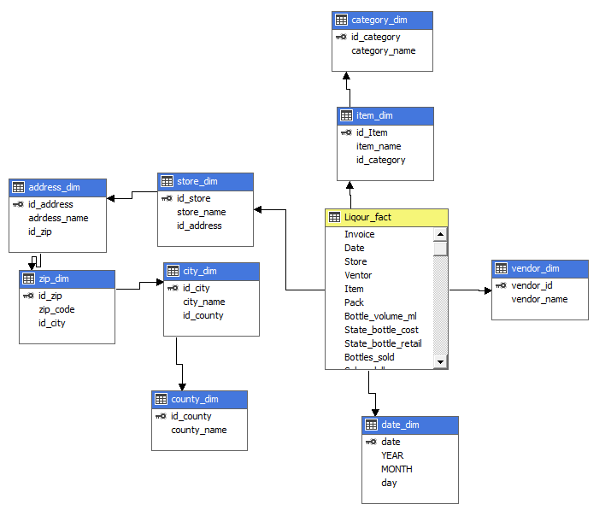
SSAS
Cube

Slide 17
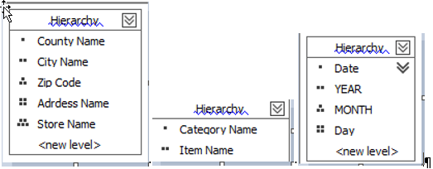
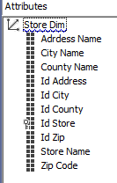
SSAS
Dimensions

Slide 18
Power BI

Slide 19

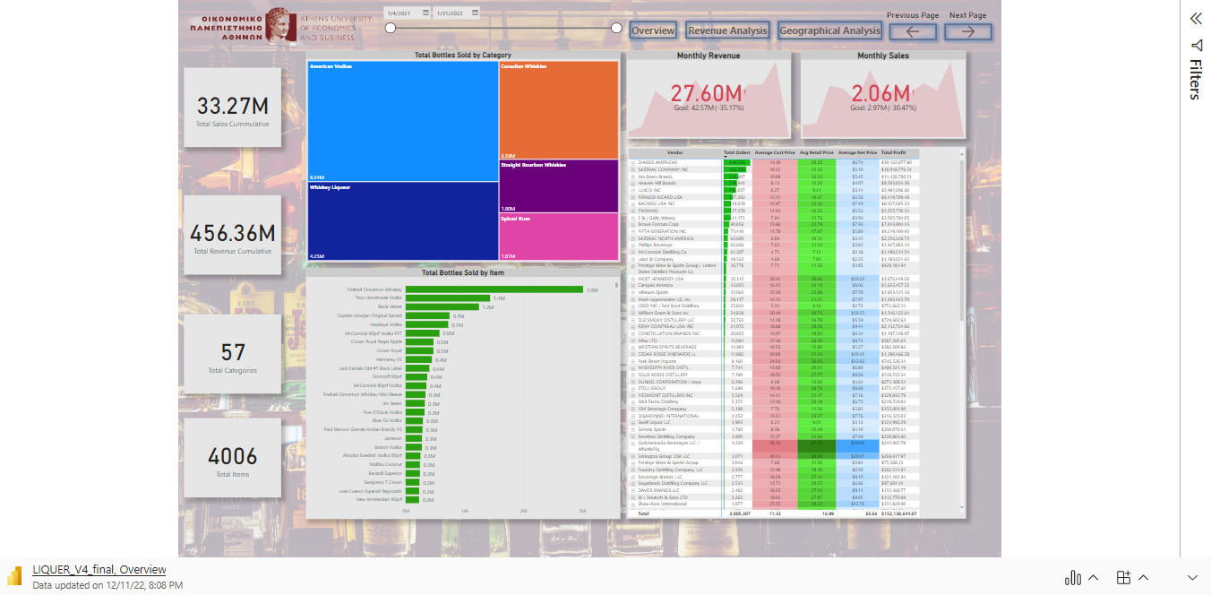
Microsoft Power BI

Slide 20
Thank you
Politis Kostas
Vaidomarkakis Panagiotis

Slide 21
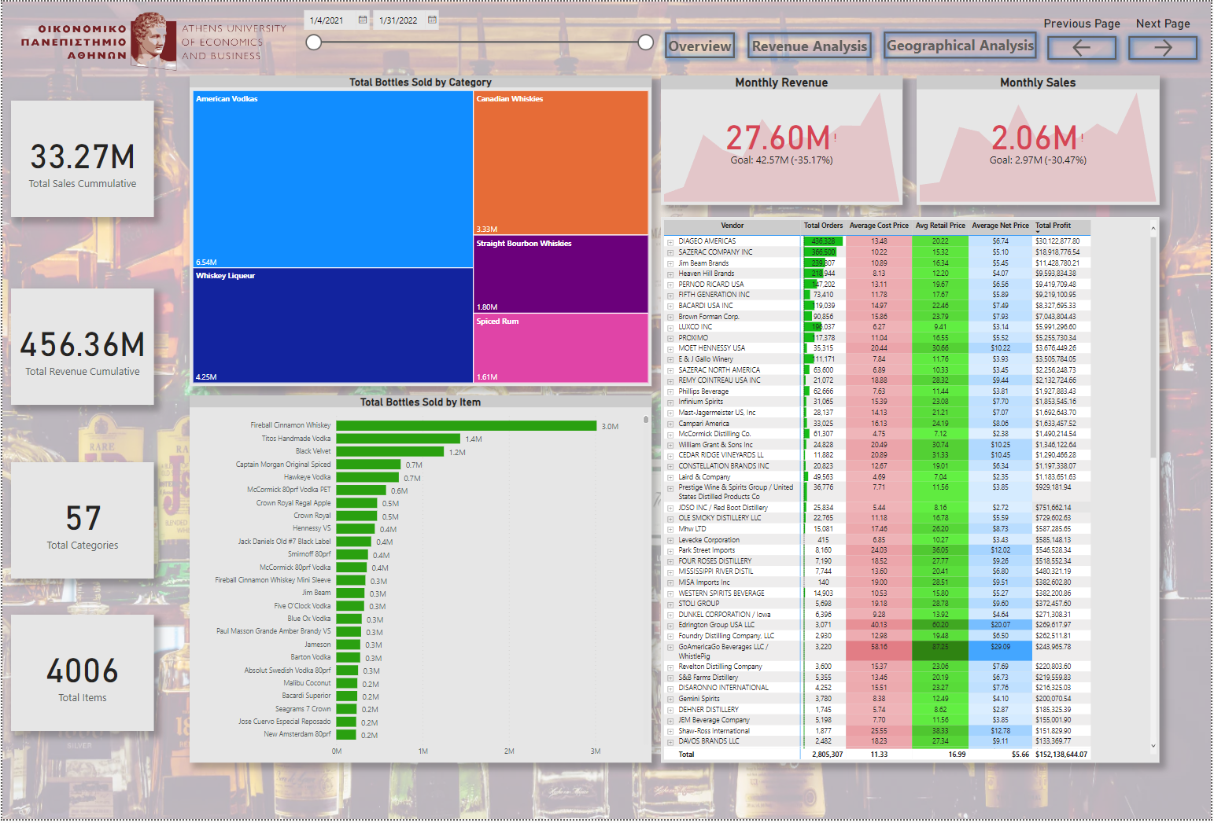

Slide 22
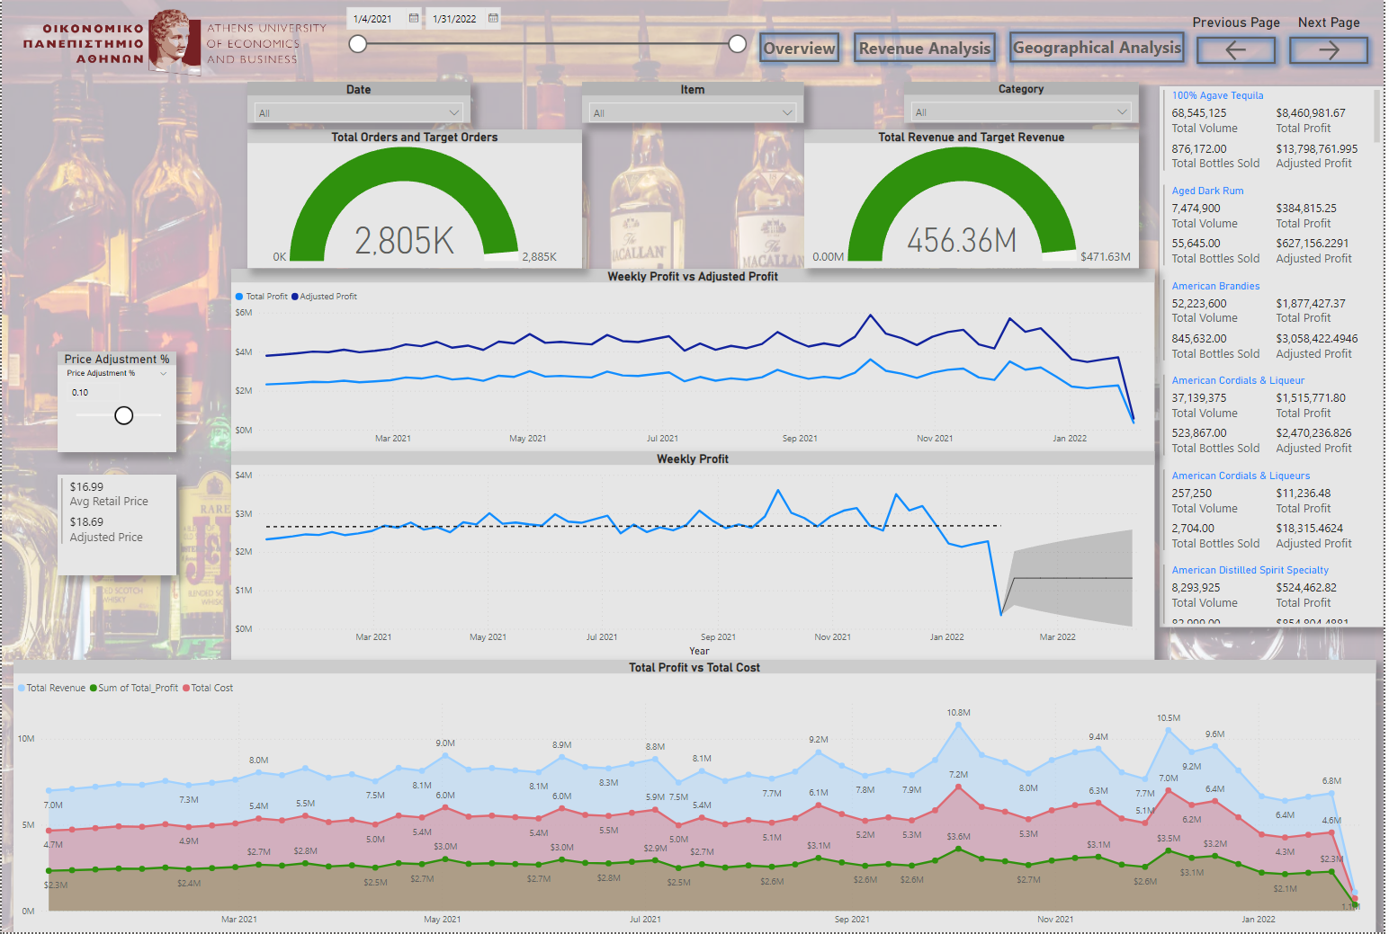

Slide 23
